Slide 1
Visualization and Analysis – Tutorial Presentation for Feedback Date: 25/11/2024
Group Id: A194 Name of Student Presenting: Ranan Barua

Slide 2
Part 1: VISUALISATION

Slide 3
We are using the dataset DS275 winequality-white.csv to answer our Research Question “Is there a difference in the mean quality rating between wines with low alcohol content and wines with high alcohol content?”
Include a sample of your .csv/xlxs dataset file to include column names (variables) in your RQ². Include number of rows: E.g. “the dataset has 655 rows and the variables we use are Valuation Our dependent variable is quality ( wine quality) and Country Our independent variable is alcohol (alcohol content)
.
Company | Valuation ($B) | Date Joined | Country
Bytedance | $140 | 4/7/2017 | China
SpaceX | $100.3 | 12/1/2012 | United States
Stripe | $95 | 1/23/2014 | United States
Klarna | $45.6 | 12/12/2011 | Sweden
Epic Games | $42 | 10/26/2018 | United States
Canva | $40 | 1/8/2018 | Australia
Checkout.com | $40 | 5/2/2019 | United Kingdom
Instacart | $39 | 12/30/2014 | United States
Databricks | $38 | 2/5/2019 | United States
Revolut | $33 | 4/26/2018 | United Kingdom
Chime | $25 | 3/5/2019 | United States
¹ Be sure you follow one of the three prescribed RQ Templates – identifying the type of statistical analysis you will be using. If you do not have the correct RQ, we will stop your presentation here.
² The variable name in your RQ may be different from the column name in cases where the column names are abbreviations.
^{3.4.}Be sure to identify which variable is your dependent variable and which one is your independent variable on this slide

Slide 4
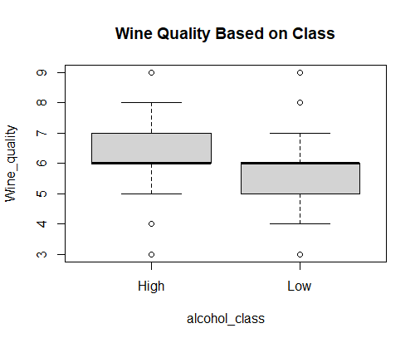
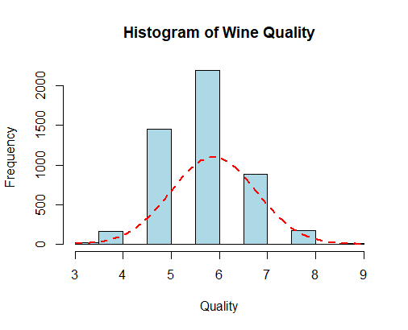
Boxplot Histogram
Comparison of means (or medians) analyses the difference between the mean (or median) value of a characteristic shared by members of two (or more) different populations.

Slide 5
Part 2: Analysis

Slide 6
Here is a Histogram showing the frequencies of our dependent variable to include the normal curve overlay (shown in blue).
Our RQ asks about Differences in means/ medians
For example:
Choose one:
1. The normal curve overlay follows the contours of the underlying data, so we use the parametric test: t-test.
OR
2. The normal curve overlay does not follow the shape of the underlying data, so we use the non-parametric test that does not assume normality: Wilcoxon also known as the Mann Whitney U Test.
The example here is borderline, in terms of shape, so when in doubt choose the non-parametric equivalent.
6

Slide 7
R Script and Results (For ALL types of test) – The Analysis
PRE 7COM1079-2022 Student Group No: ?????
7
Include a snippet of the R code you use to calculate your test statistic.
Give the value of the test statistic.
Tell us the p-value. Is it > or < 0.05?
Is the result significant?
Do you accept or reject the null hypothesis?
What does the result actually mean in the wider context of learning something useful / answering your RQ?
Notes:
7

